Slide 1


CSS Bootstrap Framework
Bootstrap is a powerful and popular CSS framework that simplifies web development. It offers pre-built components, responsive layouts, and a wide range of utility classes. This presentation will guide you through the basics of Bootstrap and how to use it to create beautiful and functional websites.
DP
by Dhruv Patel

Slide 2

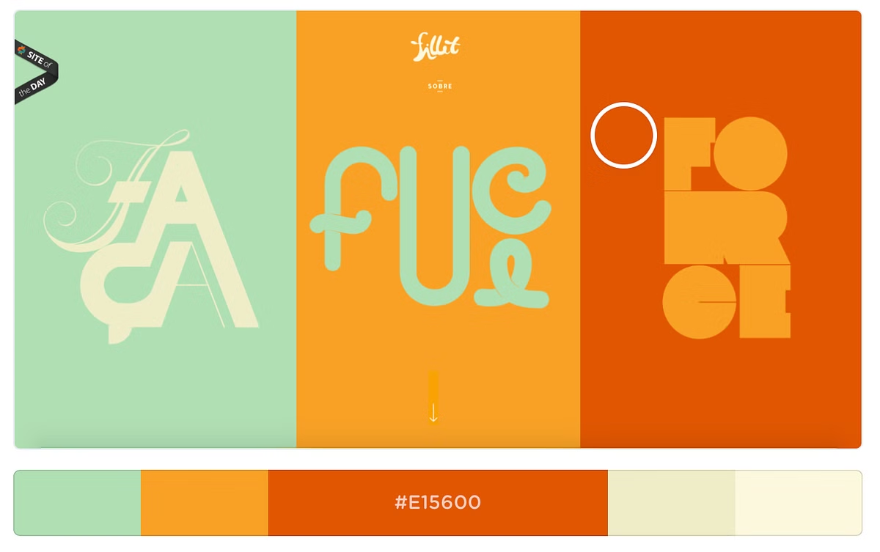
Why Use Bootstrap?
Time-Saving
Responsive Design
Bootstrap speeds up development by providing pre-designed components and styles.
Websites built with Bootstrap automatically adapt to different screen sizes.
Consistency
Bootstrap ensures consistent styling across your website, creating a unified user experience.

Slide 3

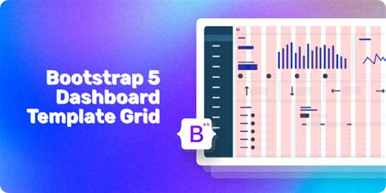
Key Features of Bootstrap
1
Grid System
2
Components
Bootstrap's grid system makes it easy to create responsive layouts.
Bootstrap provides a wide range of pre-designed components like buttons, forms, and navigation menus.
3
Utility Classes
4
Customization
Utility classes offer quick styling options like margin, padding, and text alignment.
Bootstrap can be easily customized to match your brand and design preferences.

Slide 4
Getting Started with Bootstrap
1
Include Bootstrap
Add Bootstrap's CSS and JavaScript files to your HTML project.
2
Use Components
Utilize Bootstrap's pre-built components like buttons, forms, and navigation menus.
3
Customize
Modify Bootstrap's default styles or use Sass variables to personalize its look.

Slide 5
Bootstrap Grid System
Column Structure
Responsive Layouts
Bootstrap's grid system is based on a 12-column structure, which makes it easy to create responsive layouts.
Bootstrap's grid system adjusts automatically to different screen sizes, ensuring your website looks great on all devices.

Slide 6



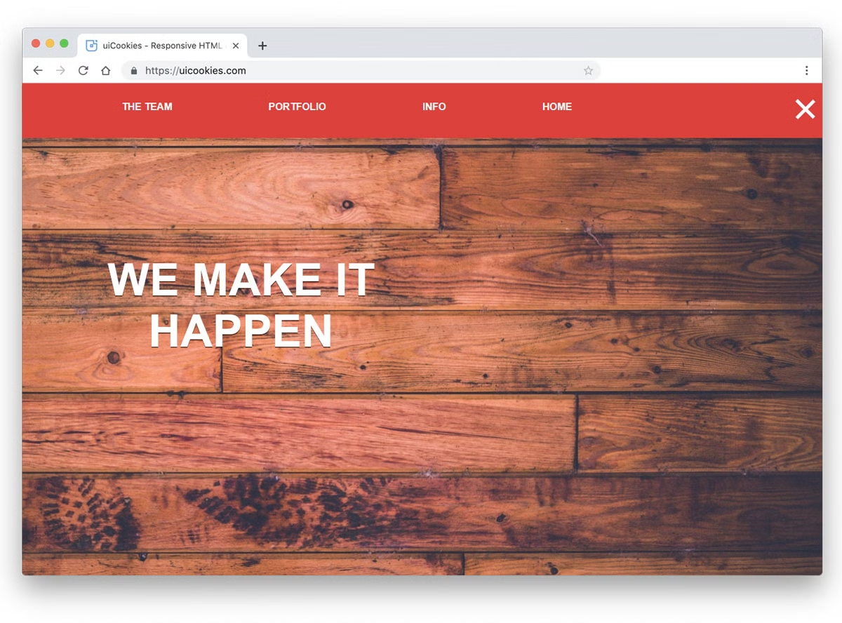


Bootstrap Components
Navigation
Forms
Create responsive navigation menus with Bootstrap's navbar component.
Bootstrap provides form components for creating user input fields and buttons.
Buttons
Cards
Bootstrap offers a variety of buttons with different styles and sizes.
Cards are versatile components that can be used to display content in a visually appealing way.

Slide 7

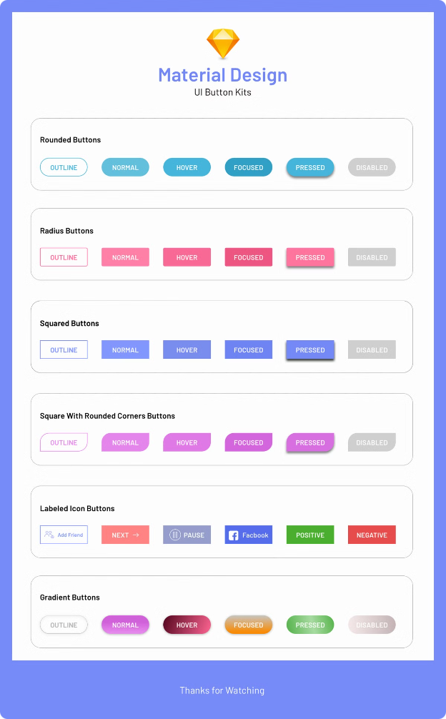



Customizing Bootstrap
Sass Variables
Bootstrap is built with Sass, allowing you to customize variables like colors and fonts.
Custom CSS
You can override Bootstrap's default styles with your own custom CSS.
JavaScript Plugins
Bootstrap offers JavaScript plugins for adding functionality like modal windows and carousels.

Slide 8
Conclusion and Resources
Bootstrap is a powerful and versatile CSS framework that makes web development faster and easier.
It's a great choice for creating responsive and visually appealing websites.
For more information, visit the official Bootstrap website: https://getbootstrap.com/

